Slide 1

8 puzzle problem with a* search
Prepared by: KANJARIA DEVANG ANILKUMAR
Enrollment No: 21002170210038
Batch :B-2
Roll No :97
Department : IT
Sem:6

Slide 2

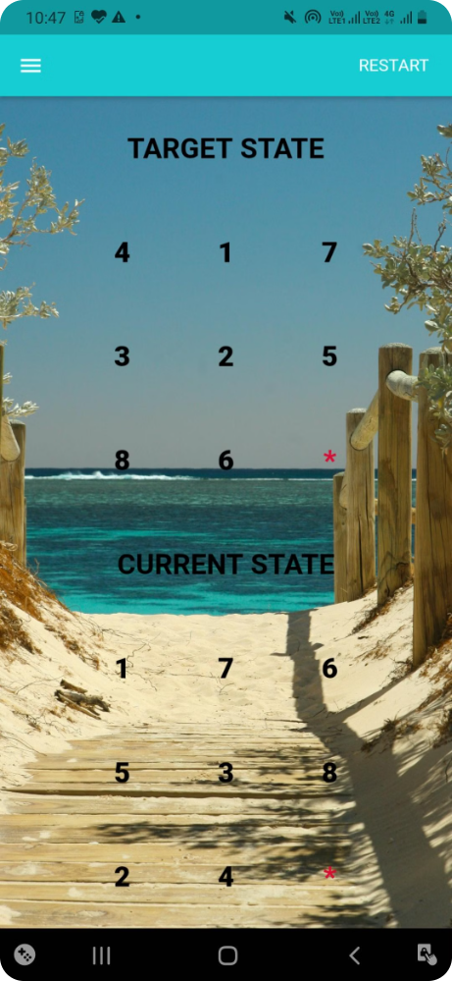
Introduction to the 8-Puzzle Problem
The 8-puzzle is a classic AI problem involving a 3x3 grid with 8 numbered tiles and a blank space. The goal is to arrange the tiles in a specific order by sliding them into the empty space.

Slide 3

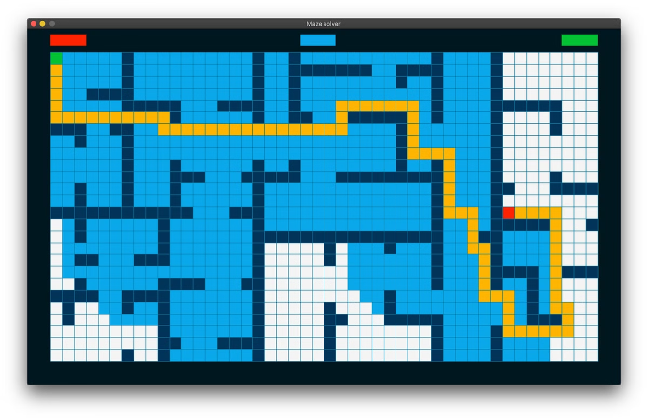
Overview of the A* Search Algorithm
A* is a widely used graph traversal and path-finding algorithm. It efficiently finds the optimal path by combining a cost function with a heuristic estimate to prioritize exploration of promising paths.
1
Cost Function
The actual cost of moving from one state to another, typically based on the number of moves.
2
Heuristic Function
An estimate of the remaining cost to reach the goal state from the current state.
3
Evaluation Function
The sum of the cost function and the heuristic function.

Slide 4
A* Search Future use age
A* search has widespread applications in real-life scenarios, including:
Robotics: Pathfinding for autonomous robots to navigate through environments.
Gaming: AI for NPC movement and decision-making.
Navigation Systems: Routing in GPS and mapping applications to find the shortest or fastest path.
Logistics and Planning: Optimizing delivery routes and warehouse operations.
AI and Machine Learning: Solving complex optimization problems and puzzles.
Medical Imaging: Planning paths for surgical robots or analyzing complex imaging data. Its efficiency and ability to find optimal solutions make A* a valuable tool across various fields.

Slide 5

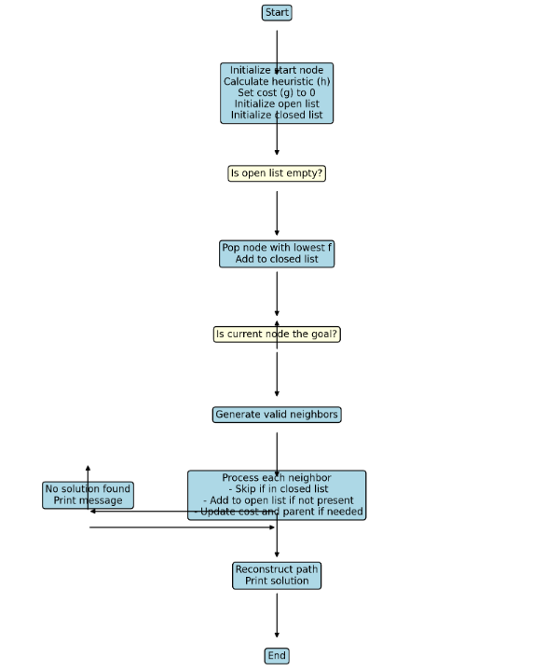
Representation of flow-chart of A*Search for 8-Puzzle Problem

Slide 6
Heuristic Functions for the A* Algorithm
Heuristic functions provide an estimate of the distance to the goal state. Common heuristics for the 8-puzzle include Manhattan distance and the number of misplaced tiles.
Manhattan Distance
Misplaced Tiles
The sum of the horizontal and vertical distances of each tile from its goal position.
The number of tiles that are not in their correct position.

Slide 7
Implementation of the A* Algorithm
The A* algorithm maintains an open list of nodes to be explored and a closed list of nodes already visited. It repeatedly selects the node with the lowest evaluation function and expands it by generating its successor nodes.
Initialize
1
Start with the initial state and an empty open list and closed list.
2
Expand Node
Select the node with the lowest evaluation function from the open list and generate its successor nodes.
Evaluate Successors
3
Calculate the evaluation function for each successor node.
4
Update Lists
Add the successor nodes to the open list and update the closed list.
Goal Test
5
If the goal state is reached, return the path; otherwise, repeat steps 2-4 until the open list is empty.

Slide 8






Optimizing the A* Algorithm
Several techniques can optimize A*'s performance, including using efficient data structures for the open and closed lists, pruning the search tree, and using more accurate heuristic functions.
Binary Heap
Prioritize nodes based on their evaluation function.
Pattern Database
Precompute heuristics for specific tile configurations.
Iterative Deepening A*
Search for solutions within increasing depth bounds.

Slide 9

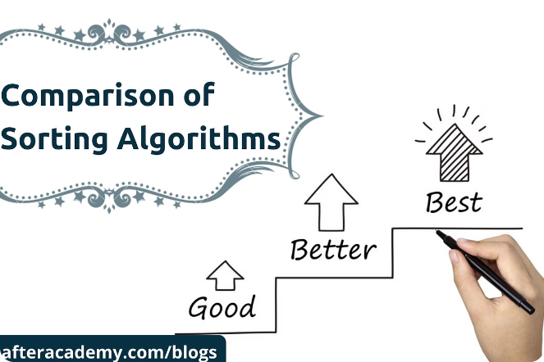
Comparing A* to Other Search Algorithms
A* offers advantages over other search algorithms, such as Breadth-First Search (BFS) and Depth-First Search (DFS), by finding optimal solutions while balancing exploration and exploitation.
BFS
Explores the graph level by level, guaranteeing an optimal solution but potentially inefficient for large graphs.
DFS
Explores deeply along a single path before backtracking, may find a solution quickly but may not be optimal.
A*
Combines BFS and DFS by using a heuristic to prioritize exploration, finding optimal solutions with better efficiency.

Slide 10





Conclusion and Future Directions
A* provides an efficient and optimal solution for the 8-puzzle problem. Future research could explore more sophisticated heuristics, adaptive search strategies, and applications of A* to other AI problems.
Advanced Heuristics
Develop more accurate heuristics that better estimate the distance to the goal state.
Real-World Applications
Apply A* to robotics, path planning, and other AI problems where optimal path finding is crucial.
Parallel A*
Explore parallel implementations of A* to further improve its performance on complex problems.

Slide 11
THANK YOU….

